Slide 1
5.1 Real Vector Spaces

Slide 2
Definition (1/2)
Let V be an arbitrary nonempty set of objects on which two operations are defined, addition and multiplication by scalars (numbers). By addition we mean a rule for associating with each pair of objects u and v in V an object u + v, called the sum of u and v; by scalar multiplication we mean a rule for associating with each scalar k and each object u in V an object ku, called the scalar multiple of u by k. If the following axioms are satisfied by all objects u, v, w in V and all scalars k and l, then we call V a vector space and we call the objects in V vectors.

Slide 3
Definition (2/2)
If u and v are objects in V, then u + v is in V.
u + v = v + u
u + (v + w) = (u + v) + w
There is an object 0 in V, called a zero vector for V, such that 0 + u = u + 0 = u for all u in V.
For each u in V, there is an object –u in V, called a negative of u, such that u + (-u) = (-u) + u = 0.
If k is any scalar and u is any object in V, then ku is in V.
k (u + v) = ku + kv
(k + l) u = ku + lu
k (lu) = (kl) (u)
1u = u

Slide 4
Remark
Depending on the application, scalars may be real numbers or complex numbers. Vector spaces in which the scalars are complex numbers are called complex vector spaces, and those in which the scalars must be real are called real vector spaces. In Chapter 10 we shall discuss complex vector spaces; until then, all of our scalars will be real numbers.
The definition of a vector space specifies neither the nature of the vectors nor the operations. Any kind of object can be a vector, and the operations of addition and scalar multiplication may not have any relationship or similarity to the standard vector operations on R^{n}. The only requirement is that the ten vector space axioms be satisfied.

Slide 5
Example 1
R^{n} Is a Vector Space
The set V = R^{n} with the standard operations of addition and scalar multiplication defined in Section 4.1 is a vector space. Axioms 1 and 6 follow from the definitions of the standard operations on R^{n}; the remaining axioms follow from Theorem 4.1.1.
The three most important special cases of R^{n} are R (the real numbers), R² (the vectors in the plane), and R³ (the vectors in 3-space).

Slide 6
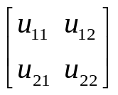
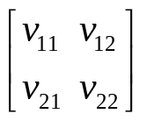

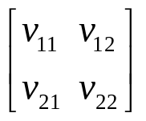
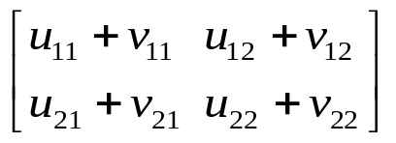
Example 2
A Vector Space of 2×2 Matrices (1/4)
Show that the set V of all 2×2 matrices with real entries is a vector
space if vector addition is defined to be matrix addition and vector
scalar multiplication is defined to be matrix scalar multiplication.
Solution.
In this example we will find it convenient to verify the axioms in the following order: 1, 6, 2, 3, 7, 8, 9, 4, 5, and 10.
Let u = and v =
To prove Axiom 1, we must show that u + v is an object in V; that is we must show that u + v is a 2×2 matrix.
u + v = + =

Slide 7
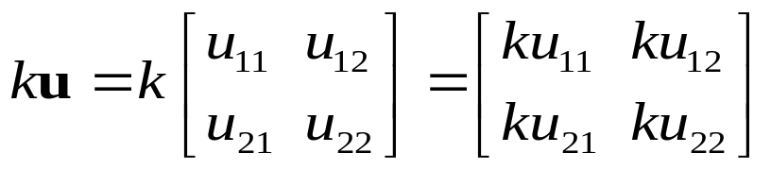
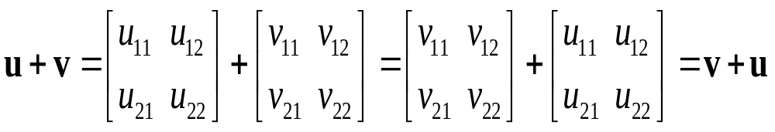
Example 2
A Vector Space of 2×2 Matrices (2/4)
Similarly, Axiom 6 hold because for any real number k we have
so that ku is a 2×2 matrix and consequently is an object in V.
Axioms 2 follows from Theorem 1.4.1a since
Similarly, Axiom 3 follows from part (b) of that theorem; and Axioms 7, 8, and 9 follow from part (h), (j), and (l), respectively.

Slide 8
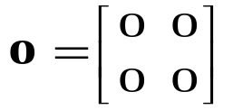
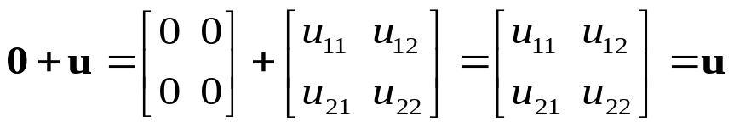
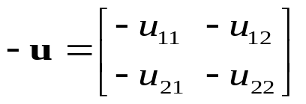
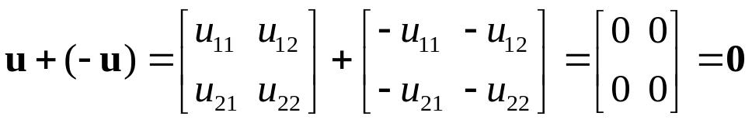
Example 2
A Vector Space of 2×2 Matrices (3/4)
To prove Axiom 4, this can be defining 0 to be
With this definition
And similarly u + 0 = u.
To prove Axiom 5, this can be done by defining the negative of u to be
With this definition
And similarly (-u) + u = 0.

Slide 9
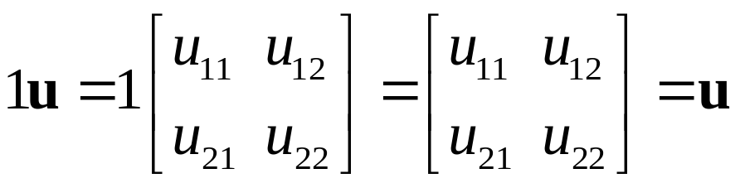
Example 2
A Vector Space of 2×2 Matrices (4/4)
Finally, Axiom 10 is a simple computation:

Slide 10
Example 3
A Vector Space of m×n Matrices
Example 2 is a special case of a more general
class of vector spaces. The arguments in that
example can be adapted to show that the set V
of all m×n matrices with real entries, together
with the operations matrix addition and scalar
multiplication, is a vector space. The m×n zero
matrix is the zero vector 0, and if u is the m×n
matrix U, then matrix –U is the negative –u of
the vector u. We shall denote this vector space by the
symbol M_{mn}.

Slide 11
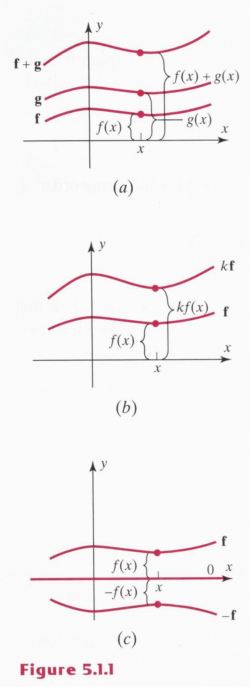
Example 4
A Vector Space of Real-Valued Functions (1/2)
Let V be the set of real-valued functions defined on the entired real line (-∞, ∞). If f = f(x) and
g = g(x) are two such functions and k is any real number, defined the sum function f + g and the scalar multiple kf, respectively, by

Slide 12
Example 4
A Vector Space of Real-Valued Functions (2/2)
In other words, the value of the function f + g at x is
obtained by adding together the values of f and g at x
(Figure 5.1.1 a). Similarly, the value of kf at x is k times
the value of f at x (Figure 5.1.1 b). In the exercises we
shall ask you to show that V is a vector space with respect
to these operations. This vector space is denoted by F(-∞,
∞). If f and g are vectors in this space, then to say that f
= g is equivalent to saying that f(x) = g(x) for all x in the
interval (-∞, ∞).
The vector 0 in F(-∞, ∞) is the constant function that
identically zero for all value of x.
The negative of a vector f is the function –f = -f(x).
Geometrically, the graph of –f is the reflection of the
graph of f across the x-axis (Figure 5.1.c).

Slide 13
Remark
In the preceding example we focused attention on the interval (-∞, ∞). Had we restricted our attention to some closed interval [a, b] or some open interval (a, b), the functions defined on those intervals with the operations stated in the example would also have produced vector spaces. Those vector spaces are denoted by F[a, b] and F(a, b).

Slide 14
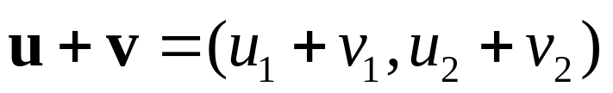


Example 5
A Set That Is Not a Vector Space
Let V = R² and define addition and scalar multiplication operations as follows: If u = (u₁, u₂) and v = (v₁, v₂), then define
and if k is any real number, then define
There are values of u for which Axiom 10 fails to hold. For example, if u = (u₁, u₂) is such that u₂ ≠ 0,then
Thus, V is not a vector space with the stated operations.

Slide 15
Example 6
Every Plane Through the Origin Is a Vector Space
Let V be any plane through the origin in R³.From Example 1, we
know that R³ itself is a vector space under these operation. Thus,
Axioms 2, 3, 7, 8, 9, and 10 hold for all points in R³ and
consequently for all points in the plane V. We therefore need only
show that Axioms 1, 4, 5, and 6 are satisfied.
Since the plane V passes through the origin, it has an equation of
the form ax + by + cz = 0. If u = (u₁, u₂, u₃) and v = (v₁, v₂, v₃)
are points in V, then au₁ + bu₂ + cu₃ = 0 and av₁ + bv₂ + cv₃ = 0.
Adding these equations gives a(u₁ + v₁) + b(u₂ + v₂) + c(u₃ + v₃)
= 0
Axiom 1: u + v = (u₁ + v₁, u₂ + v₂, u₃ + v₃); thus u + v lies in the
plane V.
Axioms 4, 6: be left as exercises.
Axioms 5: Multiplying au₁ + bu₂ + cu₃ = 0 through by -1 gives
a(-u₁) + b(-u₂) + c(-u₃) = 0 ; thus, - u = (-u₁, -u₂, -u₃) lies in V.

Slide 16
Example 7
The Zero Vector Space
Let V consist of a signal object, which we
denote by 0, and define
0 + 0 = 0 and k0 = 0 for all scalars k.
We called this the zero vector space.

Slide 17
Theorem 5.1.1
Let V be a vector space, u a vector in V,
and k a scalar; then:
0u = 0
K0 = 0
(-1)u = -u
If ku = 0 , then k = 0 or u = 0.

Slide 18
5.1 Subspaces

Slide 19
Definition
A subset W of a vector space V is called a subspace of V if W is itself a vector space under the addition and scalar multiplication defined on V.

Slide 20
Theorem 5.2.1
If W is a set of one or more vectors from a vector space V, then W is a subspace of V if and only if the following conditions hold.
If u and v are vectors in W, then u + v is in W.
If k is any scalar and u is any vector in W , then ku is in W.

Slide 21
Remark
Theorem 5.2.1 states that W is a subspace of V if and only if W is a closed under addition (condition (a)) and closed under scalar multiplication (condition (b)).

Slide 22
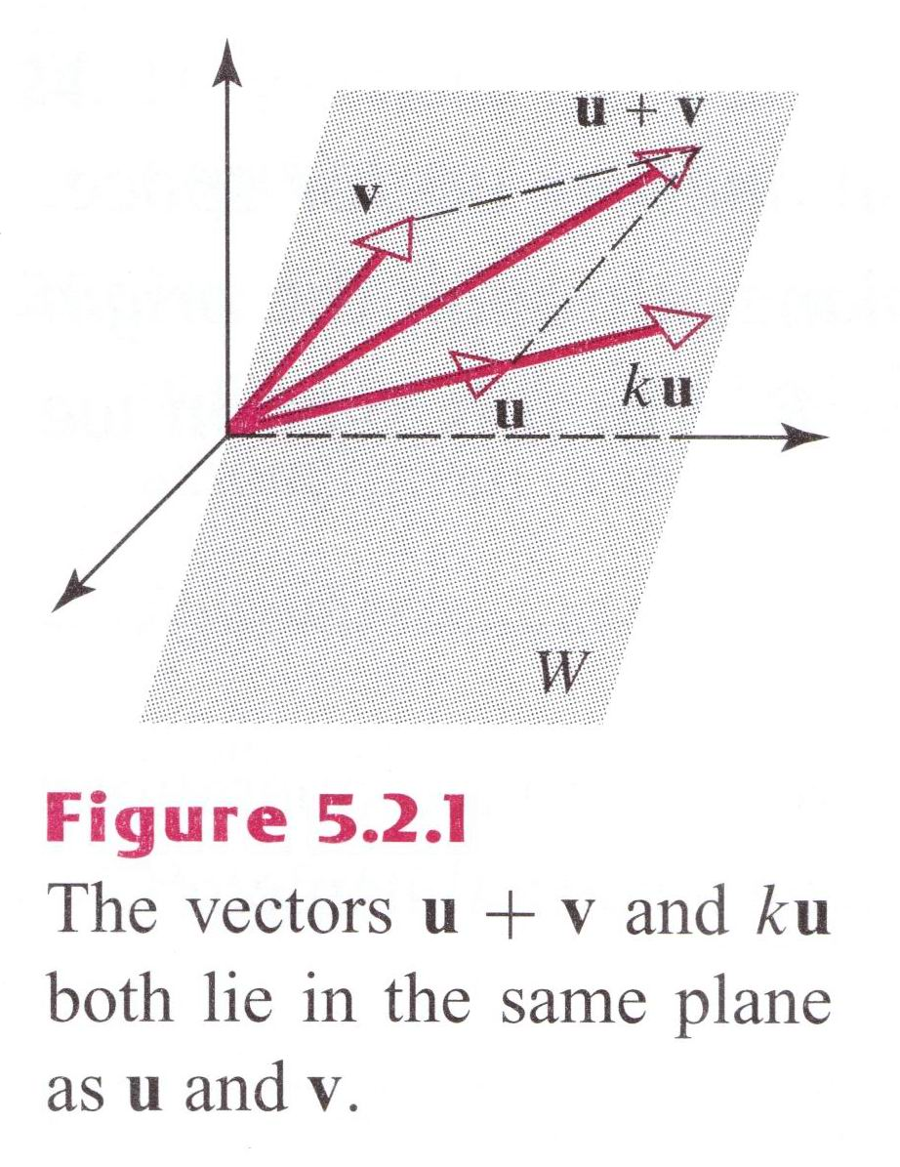
Example 1
Testing for a Subspace
Let W be any plane through the origin and let u and v be any vectors in W. Then u + v must line in W because it is the diagonal of the parallelogram determined by u and v, and ku must line in W for any scalar k because ku lies on a line through u. Thus, W is closed under addition and scalar multiplication, so it is a sunspace of R³.

Slide 23
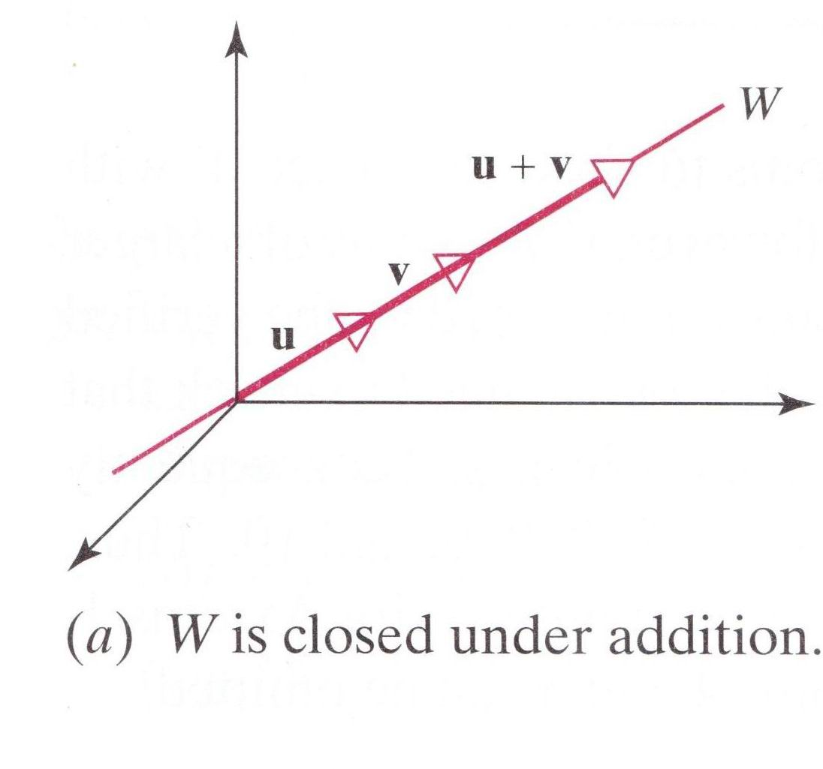
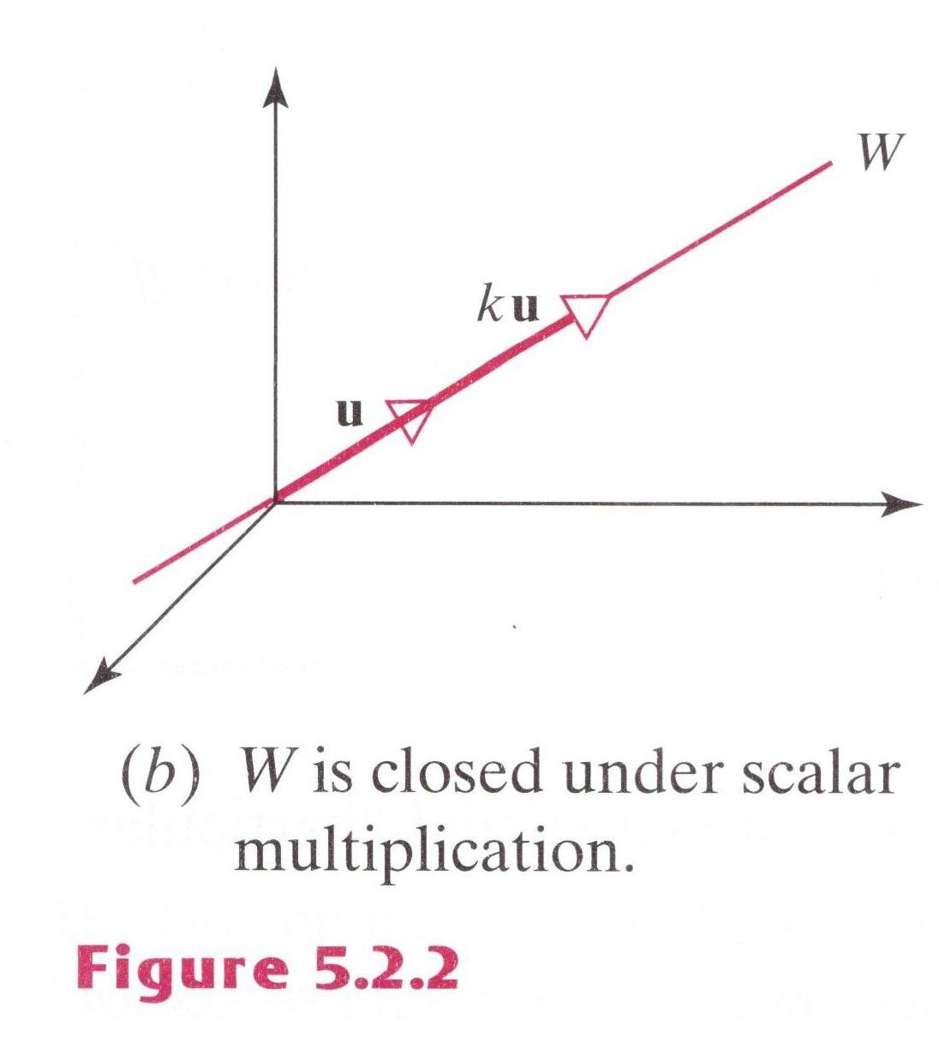
Example 2
Lines Through the Origin Are Subspaces
Show that a line through the origin of R³ is a subspace of R³.
Solution.
Let W be a line through the origin of R³.

Slide 24
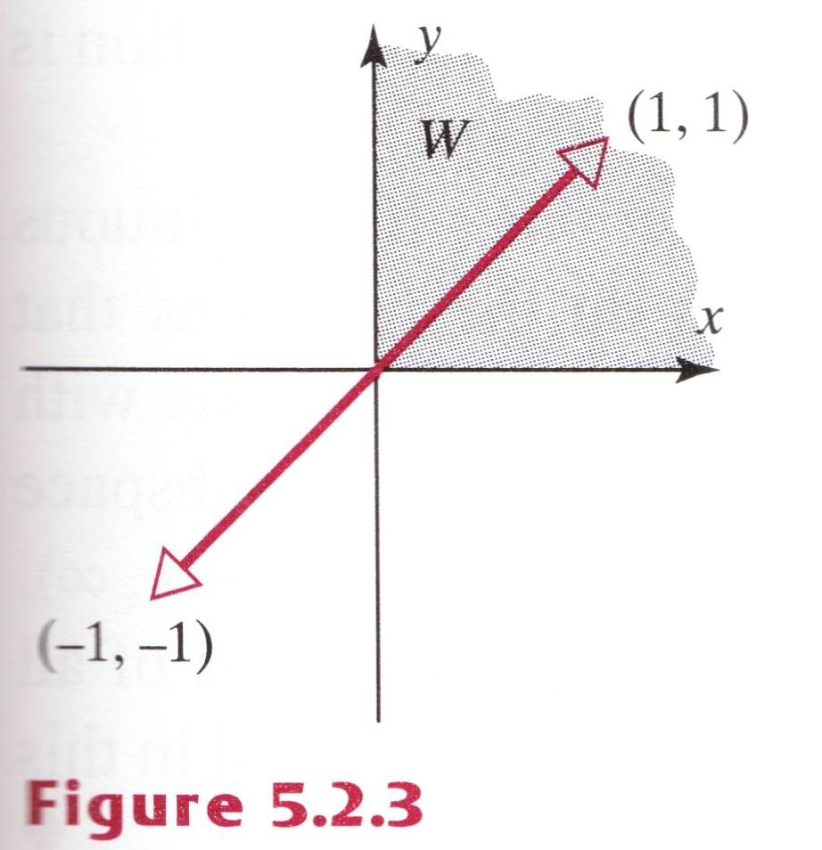
Example 3
A subspace of R² That Is Not a Subspace
Let W be the set of all points (x, y) in R² such that x ≧ 0 and y ≧ 0. These are the points in the first quadrant. The set W is not a subspace of R² since it is not closed under scalar multiplication. For example, v = (1, 1) lines in W, but its negative (-1)v = -v = (-1, -1) does not.

Slide 25
Remark
Every nonzero vector space V has at least two subspace: V itself is a subspace, and the set {0} consisting of just the zero vector in V is a subspace called the zero subspace.
Combining this with Example 1 and 2, we obtain the following list of subspaces of R² and R³:
Subspace of R²
{0}
Lines through the origin
R²
Subspace of R³
{0}
Lines through the origin
Planes through origin
R³
These are the only subspaces of R² and R³.

Slide 26
Example 4
Subspaces of M_{nn}
From Theorem 1.7.2 the sum of two symmetric matrices is symmetric, and a scalar multiple of a symmetric matrix is symmetric. Thus, the set of n×n symmetric matrices is a subspace of the vector space M_{nn} of n×n matrices. Similarly, the set of n×n upper triangular matrices, the set of n×n lower triangular matrices, and the set of n×n diagonal matrices all form subspaces of M_{nn}, since each of these sets is closed under addition and scalar multiplication.

Slide 27
Example 5
A Subspace of Polynomials of Degree ≦ n
Let n be a nonnegative integer, and let W consist of all function expressible in the form
where a₀,…,a_{n} are real number.
Let p and q be the polynomials
Then
and
These functions have the form given in (1), so p + q and kp lie in W. We shall denote the vector space W in this example by the symbol P_{n} .

Slide 28
Example 6
Subspaces of Functions Continuous on (-∞, ∞) (1/3)
Recall from calculus that if f and g are continuous functions on the interval (-∞, ∞) and k is a constant, then f + g and kf are also continuous. Thus, the continuous functions on the interval (-∞, ∞) form a subspace of F(-∞, ∞), since they are closed under addition and scalar multiplication. We denote this subspace by C(-∞, ∞). Similarly, if f and g have continuous first derivatives on (-∞, ∞) form a subspace of F(-∞, ∞). We denote this subspace by C¹(-∞, ∞), where the subscript 1 is used to emphasize the first derivate. However, it is a theorem of calculus that every differentiable function is continuous, so C¹(-∞, ∞) is actually a subspace of C(-∞, ∞).

Slide 29
Example 6
Subspaces of Functions Continuous on (-∞, ∞) (2/3)
To take this a step further, for each positive integer m, the functions with continuous m th derivatives on (-∞, ∞) form a subspace of C¹(-∞, ∞) as do the functions that have continuous derivates of all orders. We denote the subspace of functions with continuous m th derivatives on (-∞, ∞) by C^{m}(-∞, ∞), and we denote the subspace of functions that have continuous derivatives of all order on (-∞, ∞) by C∞(-∞, ∞). Finally, it is a theorem of calculus that polynomials have continuous derivatives of all order, so P_{n} is a subspace of C∞(-∞, ∞).

Slide 30
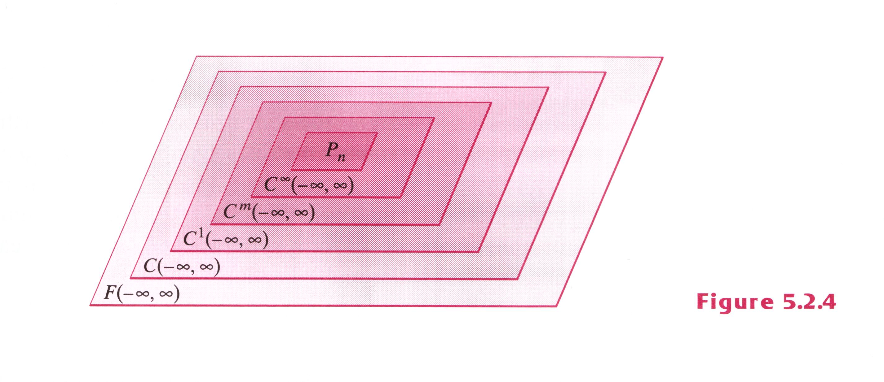
Example 6
Subspaces of Functions Continuous on (-∞, ∞) (3/3)

Slide 31
Solution Space of Homogeneous Systems
If Ax = b is a system of the linear equations, then each vector x that satisfies this equation is called a solution vector of the system. The following theorem shows that the solution vectors of a homogeneous linear system form a vector space, which we shall call the solution space of the system.

Slide 32
Theorem 5.2.2
If Ax = 0 is a homogeneous linear system of m equations in n unknowns, then the set of solution vectors is a subspace of R^{n}.

Slide 33
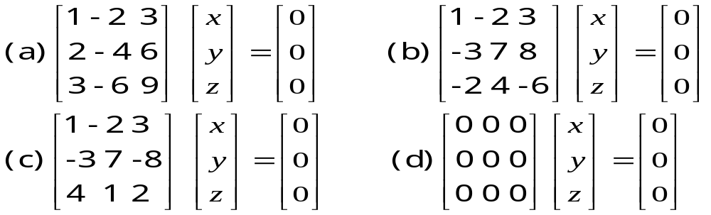
Example 7
Solution Spaces That Are Subspaces of R³ (1/2)
Each of these systems has three unknowns, so the solutions form subspaces of R³. Geometrically, this means that each solution space must be a line through the origin, a plane through the origin, the origin only, or all of R³. We shall now verify that this is so.

Slide 34
Example 7
Solution Spaces That Are Subspaces of R³ (2/2)
Solution.
(a) x = 2s - 3t, y = s, z = t
x = 2y - 3z or x – 2y + 3z = 0
This is the equation of the plane through the origin with n = (1, -2, 3) as a normal vector.
(b) x = -5t , y = -t, z=t
which are parametric equations for the line through the origin parallel to the vector v = (-5, -1, 1).
(c) The solution is x = 0, y = 0, z = 0, so the solution space is the origin only, that is {0}.
(d) The solution are x = r , y = s, z = t, where r, s, and t have arbitrary values, so the solution space is all of R³.

Slide 35
Definition
A vector w is a linear combination of the vectors v₁, v₂,…, v_{r} if it can be expressed in the form
w = k₁v₁ + k₂v₂ + … + k_{r}v_{r}
where k₁, k₂, …, k_{r} are scalars.

Slide 36
Example 8
Vectors in R³ Are Linear Combinations of i, j, and k
Every vector v = (a, b, c) in R³ is expressible as a linear combination of the standard basis vectors
i = (1, 0, 0), j = (0, 1, 0), k = (0, 0, 1)
since
v = (a, b, c) = a(1, 0, 0) + b(0, 1, 0) + c(0, 0, 1) = ai + bj + ck

Slide 37
Example 9
Checking a Linear Combination (1/2)
Consider the vectors u = (1, 2, -1) and v = (6, 4, 2) in R³. Show that w = (9, 2, 7) is a linear combination of u and v and that w′ = (4, -1, 8) is not a linear combination of u and v.
Solution.
In order for w to be a linear combination of u and v, there must be scalars k₁ and k₂ such that w = k₁u + k₂v;
(9, 2, 7) = (k₁ + 6k₂, 2k₁ + 4k₂, -k₁ + 2k₂)
Equating corresponding components gives
k₁ + 6k₂ = 9
2k₁ + 4k₂ = 2
-k₁ + 2k₂ = 7
Solving this system yields k₁ = -3, k₂ = 2, so
w = -3u + 2v

Slide 38
Example 9
Checking a Linear Combination (2/2)
Similarly, for w′ to be a linear combination of u and v, there must be scalars k₁ and k₂ such that w′= k₁u + k₂v;
(4, -1, 8) = k₁(1, 2, -1) + k₂(6, 4, 2)
or
(4, -1, 8) = (k₁ + 6k₂, 2k₁ + 4k₂, -k₁ + 2k₂)
Equating corresponding components gives
k₁ + 6k₂ = 4
2 k₁ + 4k₂ = -1
- k₁ + 2k₂ = 8
This system of equation is inconsistent, so no such scalars k₁ and k₂ exist. Consequently, w′ is not a linear combination of u and v.

Slide 39
Theorem 5.2.3
If v₁, v₂, …, v_{r} are vectors in a vector space V, then:
The set W of all linear combinations of v₁, v₂, …, v_{r} is a subspace of V.
W is the smallest subspace of V that contain v₁, v₂, …, v_{r} in the sense that every other subspace of V that contain v₁, v₂, …, v_{r} must contain W.

Slide 40
Definition
If S = {v₁, v₂, …, v_{r}} is a set of vectors in a vector space V, then the subspace W of V containing of all linear combination of these vectors in S is called the space spanned by v₁, v₂, …, v_{r}, and we say that the vectors v₁, v₂, …, v_{r} span W. To indicate that W is the space spanned by the vectors in the set S = {v₁, v₂, …, v_{r}}, we write
W = span(S) or W = span{v₁, v₂, …, v_{r}}

Slide 41
Example 10
Spaces Spanned by One or Two Vectors (1/2)
If v₁ and v₂ are nonlinear vectors in R³ with their initial points at the origin, then span{v₁, v₂}, which consists of all linear combinations k1 v₁ + k2 v₂ is the plane determined by v₁ and v₂. Similarly, if v is a nonzero vector in R² and R³, then span{v}, which is the set of all scalar multiples kv, is the linear determined by v.

Slide 42
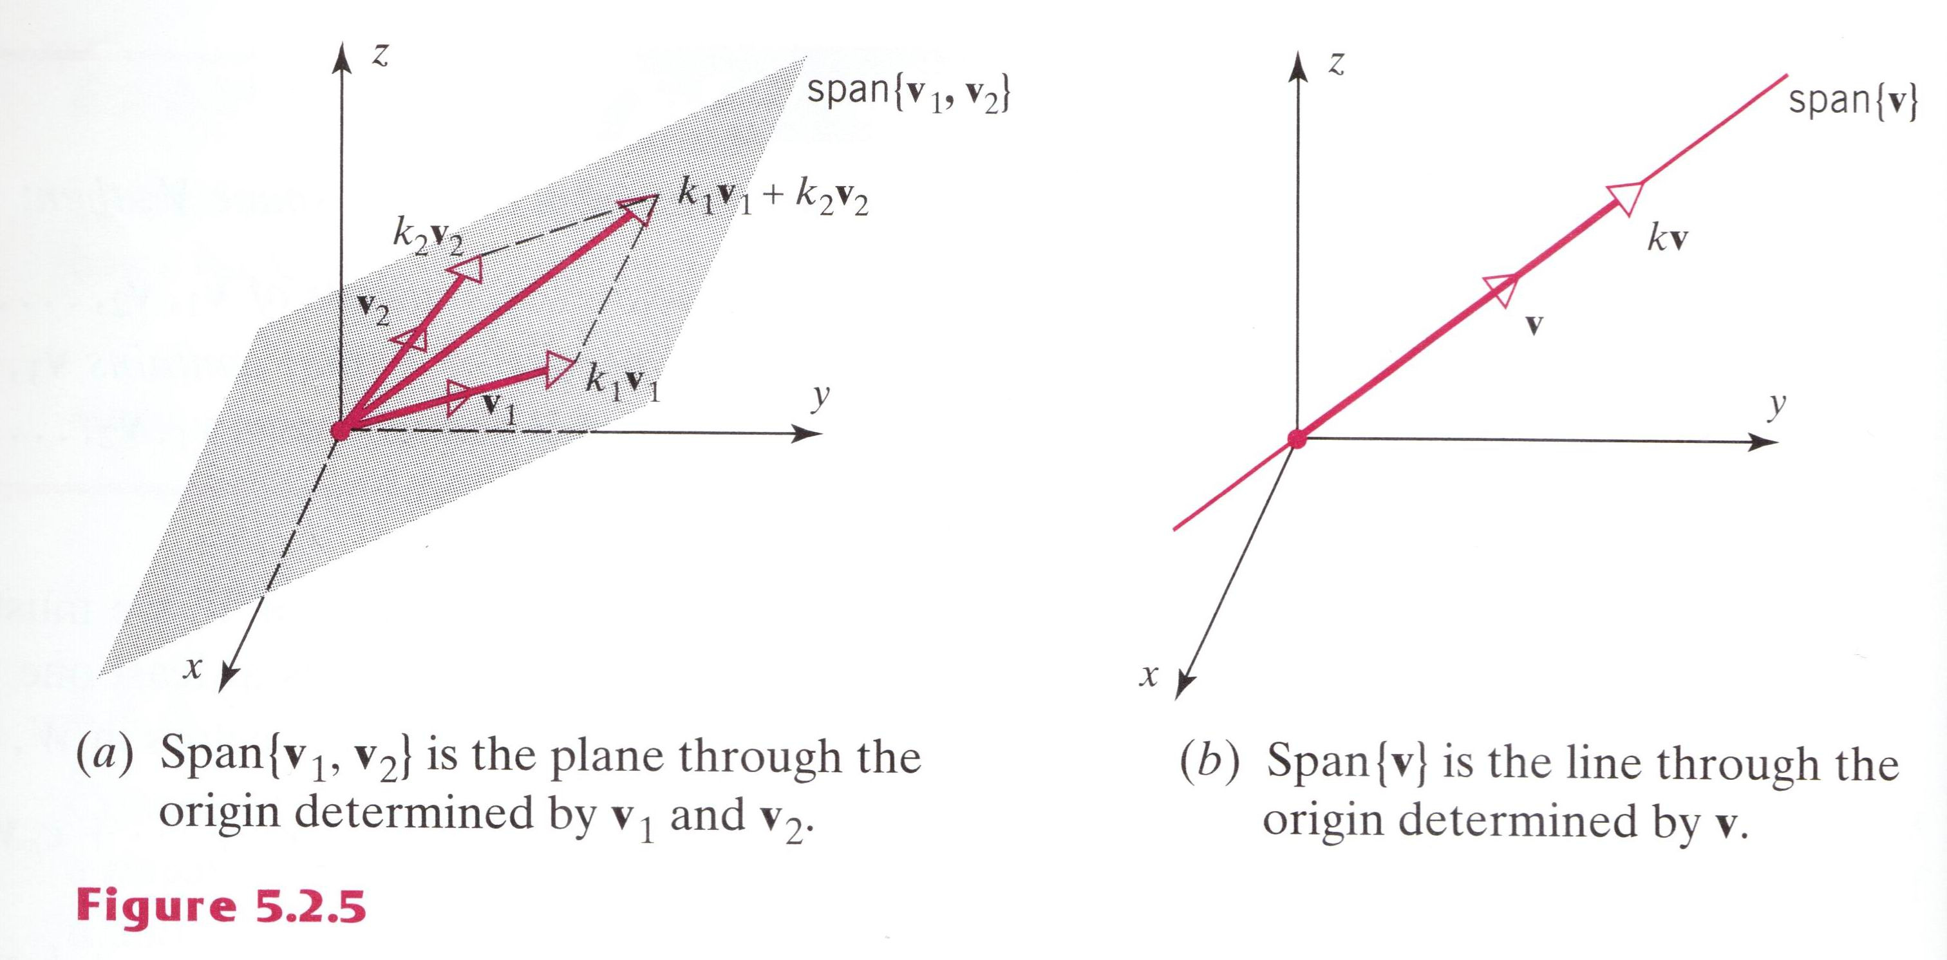
Example 10
Spaces Spanned by One or Two Vectors (2/2)

Slide 43
Example 11
Spanning Set for P_{n}
The polynomials 1, x, x², …, x^{n} span the vector space P_{n} defined in Example 5 since each polynomial p in P_{n} can be written as
p = a₀ + a₀x + … + a_{n}x^{n}
which is a linear combination of 1, x, x², …, x^{n}. We can denote this by writing
P_{n} = span{1, x, x², …, x^{n}}

Slide 44
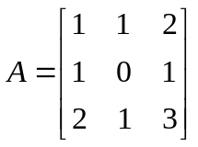
Example 12
Three Vectors That Do Not Span R³
Determine whether v₁ = (1, 1, 2), v₂ = (1, 0, 1), and v₃ = (2, 1, 3) span the vector space R³.
Solution.
We must determine whether an arbitrary vector b = (b₁, b₂, b₃) in R3 can be expressed as a linear combination b = k₁v₁ + k₂v₂ + k₃v₃
Expressing this equation in terms of components gives (b₁, b₂, b₃) = k₁(1, 1, 3) + k₂(1, 0, 1) + k₃(2, 1 ,3) or (b₁, b₂, b₃) = (k₁ + k₂ + 2k₃, k₁ + k₃, 2k₁ + k₂ + 3 k₃)
or
k₁ + k₂ + 2k₃ = b₁
k₁ + k₃ = b₂
2k₁ + k₂ + 3 k₃ = b₃
by parts (e) and (g) of Theorem 4.3.4, this system is consistent for all b₁, b₂, and b₃ if and only if the coefficient matrix
has a nonzero determinant. However, det(A) = 0, so that v₁, v₂, and v₃, do not span R3.

Slide 45
Theorem 5.2.4
If S = {v₁, v₂, …, v_{r}} and S′ = {w₁, w₂, …, w_{r}} are two sets of vector in a vector space V, then
span{v₁, v₂, …, v_{r}} = span{w₁, w₂, …, w_{r}}
if and only if each vector in S is a linear combination of these in S′ and each vector in S′ is a linear combination of these in S.

Slide 46
5.3 Linear Independence

Slide 47
Definition
If S={v₁, v₂, …, v_{r}} is a nonempty set of vector, then the vector equation
k₁v₁+k₂v₂+…+k_{r}v_{r}=0
has at least one solution, namely
k₁=0, k₂=0, …, k_{r}=0
If this the only solution, then S is called linearly independent set. If there are other solutions, then S is called a linear dependent set.

Slide 48
Example 1
A Linear Dependent Set
If v₁=(2, -1, 0, 3), v₂=(1, 2, 5, -1), and v₃=(7, -1, 5, 8), then the set of vectors S={v₁, v₂, v₃} is linearly dependent, since 3v₁+v₂-v₃=0.

Slide 49
Example 2
A Linearly Dependent Set
The polynomials
p₁=1-x, p₂=5+3x-2x², and p₃=1+3x-x²
form a linear dependent set in P₂ since 3p₁-p₂+2p₃=0.

Slide 50
Example 3
Linear Independent Sets
Consider the vectors i=(1, 0, 0), j=(0, 1, 0), and k=(0, 0, 1) in R₃. In terms of components the vector equation
k₁i+k₂j+k₃k=0
becomes
k₁(1, 0, 0)+k₂(0, 1, 0)+k₃(0, 0, 1)=(0, 0, 0)
or equivalently,
(k₁, k₂, k₃)=(0, 0, 0)
So the set S={i, j, k} is linearly independent.
A similar argument can be used to show the vectors
e₁=(1, 0, 0, …,0), e₂=(0, 1, 0, …, 0), …, e_{n}=(0, 0, 0, …, 1)
form a linearly independent set in R^{n}.

Slide 51
Example 4
Determining Linear Independence/Dependence (1/2)
Determine whether the vectors
v₁=(1, -2, 3), v₂=(5, 6, -1), v₃=(3, 2, 1)
form a linearly dependent set or a linearly independent set.
Solution.
In terms of components the vector equation
k₁v₁+k₂v₂+k₃v₃=0
becomes
k₁(1, -2, 3)+k₂(5, 6, -1)+k₃(3, 2, 1)=(0, 0, 0)
Thus, v₁ , v₂, and v₃ form a linearly dependent set if this system has a nontrivial solution, or a linearly independent set if it has only the trivial solution. Solving this system yields
k₁=-1/2t, k₂=-1/2t, k₃=t

Slide 52
Example 4
Determining Linear Independence/Dependence (2/2)
Thus, the system has nontrivial solutions and v₁,v₂, and v₃ form a linearly dependent set. Alternatively, we could show the existence of nontrivial solutions by showing that the coefficient matrix has determinant zero.

Slide 53
Example 5
Linearly Independent Set in P_{n}
Show that the polynomials
1, x, x², …, x^{n}
form a linearly independent set of vectors in P_{n}.
Solution.
Let p₀=1, p₁=x, p₂= x², …, p_{n}=x^{n} and assume
a₀p₀+a₁p₁+a₂p₂+ …+a_{n}p_{n}=0
or equivalently,
a₀+a₁x+a₂x²+ …+a_{n}x^{n}=0 for all x in (-∞,∞) (1)
we must show that
a₀=a₁=a₂= …=a_{n}=0
Recall from algebra that a nonzero polynomial of degree n has at most n distinct roots. But this implies that a₀=a₁=a₂= …=a_{n}=0; otherwise, it would follow from (1) that a₀+a₁x+a₂x²+ …+a_{n}x^{n} is a nonzero polynomial with infinitely many roots.

Slide 54
Theorem 5.3.1
A set with two or more vectors is:
Linearly dependent if and only if at least one of the vectors in S is expressible as a linear combination of the other vectors in S.
Linearly independent if and only if no vector in S is expressible as a linear combination of the other vectors in S.

Slide 55
Example 6
Example 1 Revisited
In Example 1 we saw that the vectors
v₁=(2, -1, 0, 3), v₂=(1, 2, 5, -1), and v₃=(7, -1, 5, 8)
Form a linearly dependent set. In this example each vector is expressible as a linear combination of the other two since it follows from the equation 3v₁+v₂-v₃=0 that
v₁=-1/3v₂+1/3v₃, v₂=-3 v₁+v₃, and v₃=3v₁+v₂

Slide 56
Example 7
Example 3 Revisited
Consider the vectors i=(1, 0, 0), j=(0, 1, 0), and k=(0, 0, 1) in R₃.
Suppose that k is expressible as
k=k₁i+k₂j
Then, in terms of components,
(0, 0, 1)=k₁(1, 0, 0)+k₂(0, 1, 0) or (0, 0, 1)=(k₁, k₂, 0)
But the last equation is not satisfied by any values of k₁ and k₂, so k cannot be expressed as a linear combination of i and j. Similarly, i is not expressible as a linear combination of j and k, and j is not expressible as a linear combination of i and k.

Slide 57
Theorem 5.3.2
A finite set of vectors that contains the zero vector is linearly dependent.
A set with exactly two vectors is linearly independently if and only if neither vector is a scalar multiple of the other.

Slide 58
Example 8
Using Theorem 5.3.2b
The function f₁=x and f₂=sin x form a linear independent set of vectors in F(-∞, ∞), since neither function is a constant multiple of the other.

Slide 59
Geometric Interpretation of Linear Independence (1/2)
Linear independence has some useful geometric interpretations in R² and R³:
In R² and R³, a set of two vectors is linearly independent if and only if the vectors do not lie on the same line when they are placed with their initial points at the origin (Figure 5.3.1).
In R³, a set of three vectors is linearly independent if and only if the vectors do not lie in the same plane when they are placed with their initial points at the origin (Figure 5.2.2).

Slide 60
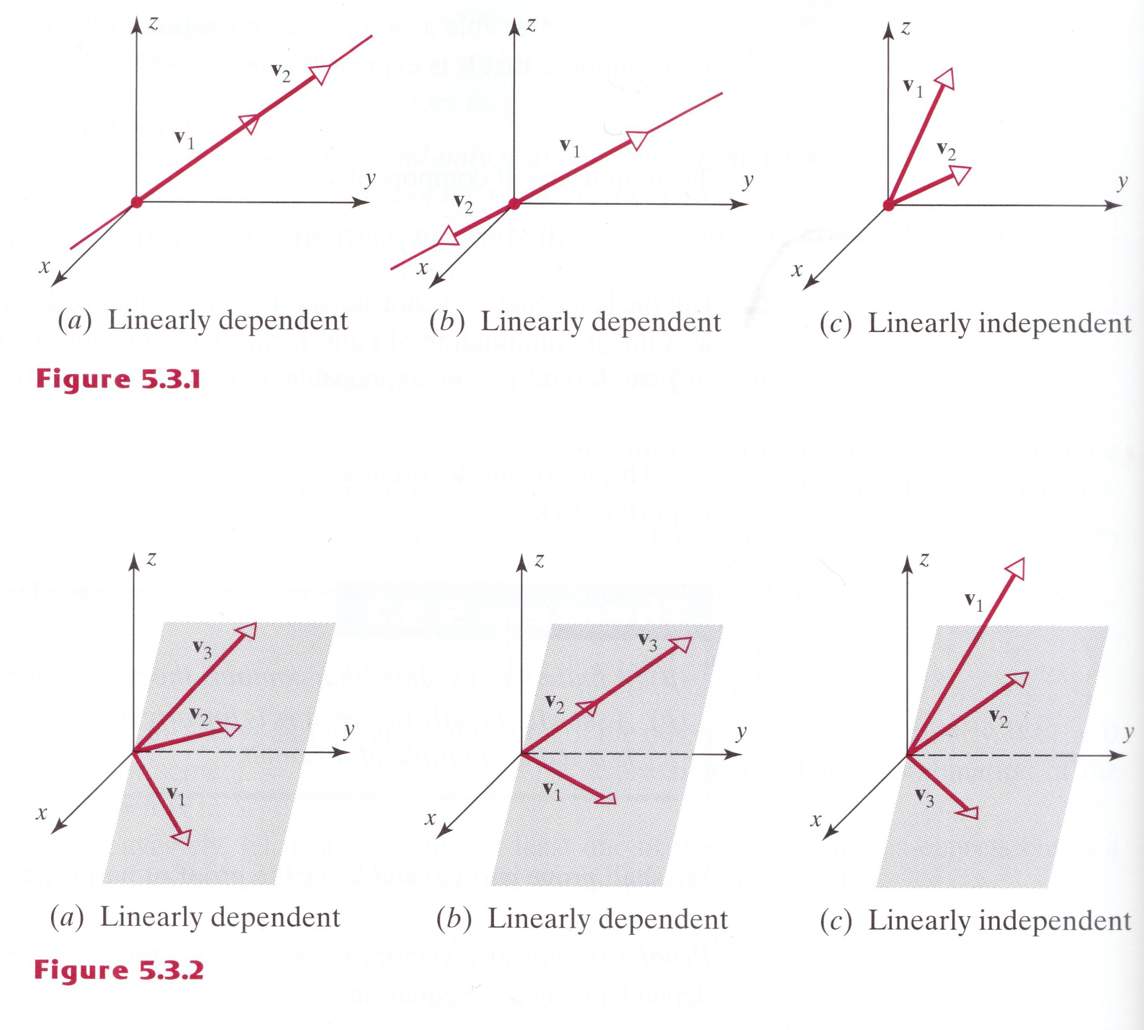
Geometric Interpretation of Linear Independence (2/2)

Slide 61
Theorem 5.3.3
Let S={v₁, v₂, …, v_{r}} be a set of vectors in R^{n}. If r>n, then S is linearly dependent.

Slide 62
Remark
The preceding theorem tells us that a set in R² with more than two vectors is linearly dependent, and a set in R³ with more than three vectors is linearly dependent.

Slide 63
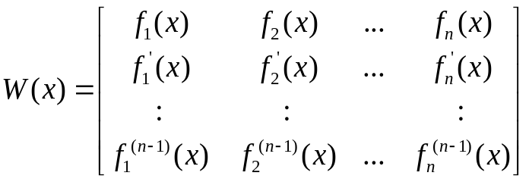
Linear Independence of Functions (1/2)
If f₁=f₁(x), f₂=f₂(x), …, f_{n}=f_{n}(x) are n-1 times differentiable functions on the interval (-∞,∞), then the determinant of
Is called the Wronskian of f₁, f₂, …,f_{n}. As we shall now know, this determinant is useful for ascertaining whether the functions f₁, f₂, …,f_{n} form a linear independent set of vectors in the vector space C^{(n-1)}(-∞,∞). Suppose, for the moment, that f₁, f₂, …,f_{n} are linear dependent vectors in C^{(n-1)}(-∞,∞). Then, there exist scalars k₁, k₂, …, k_{n}, not all zero, such that
k₁f₁(x)+ k₂f₂(x)+…+ k_{n}f_{n}(x)=0
for all x in the interval (-∞,∞). Combining this equation with the equations obtained by n-1 successive differentiations yields

Slide 64
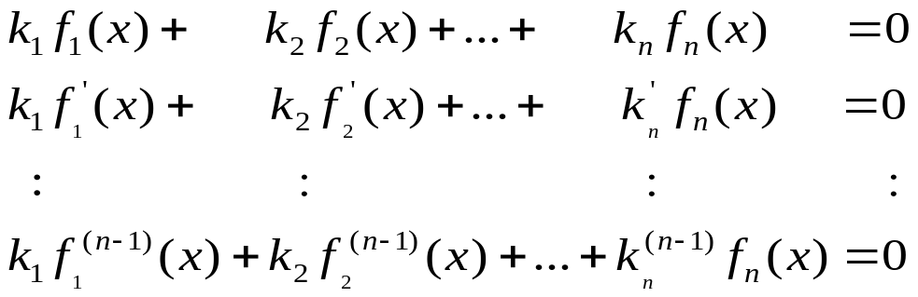
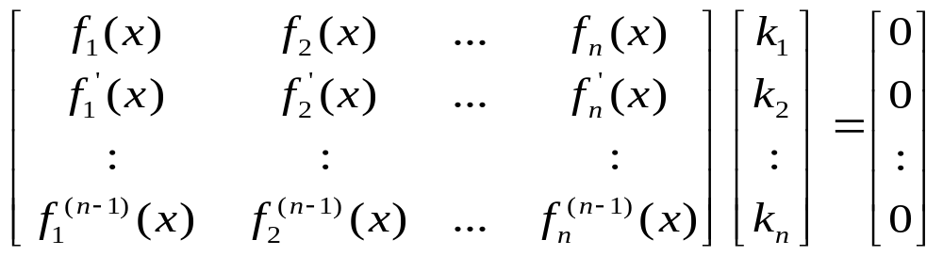
Linear Independence of Functions (2/2)
Thus, the linear dependence of f₁, f₂, …,f_{n} implies that the linear system
has a nontrivial solution for every x in the interval (-∞,∞). This implies in turn that for every x in (-∞,∞) the coefficient matrix is not invertible, or equivalently, that its determinant (the Wronskian) is zero for ever x in (-∞,∞).

Slide 65
Theorem 5.3.4
If the functions f₁, f₂, …,f_{n} have n-1 continuous derivatives on the interval (-∞,∞), and if the Wronskian of these functions is not identically zero on (-∞,∞), then these functions form a linearly independent set of vectors in C^{(n-1)}(-∞,∞).

Slide 66
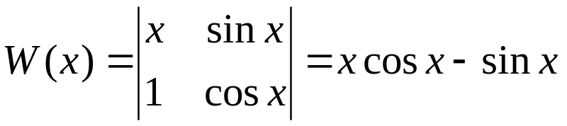
Example 9
Linearly Independent Set in C¹(-∞,∞)
Show that the functions f₁=x and f₂=sin x form a linearly independent set of vectors in C¹(-∞,∞).
Solutions.
The Wronskian is
This function does not have value zero for all x in the interval (-∞,∞), so f₁ and f₂ form a linearly independent set.

Slide 67
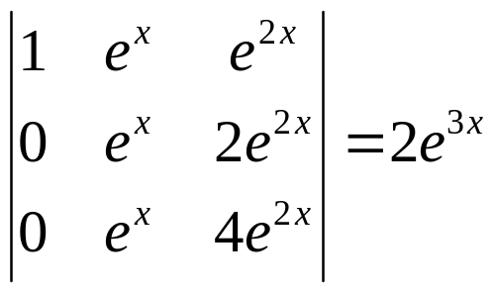
Example 10
Linearly Independent Set in C²(-∞,∞)
Show that the functions f₁=1 and f₂=e^{x} , and f3=e^{2x} form a linearly independent set of vectors in C²(-∞,∞).
Solution.
The Wronskian is
This function does not have value zero for all x (in fact, for any x) in the interval (-∞,∞), so f₁, f₂, and f₃ form a linearly independent set.

Slide 68
Remark
If the Wronskian of f₁, f₂, …,f_{n} is identically zero on (-∞,∞), then no conclusion can be reached the linear independence of {f₁, f₂, …,f_{n}}; this set of vectors may be linearly independent or linearly dependent.

